Slide 1

The Holographic- Fractal Universe
By Zachary Moote

Slide 2
The Cellular Gateway
The universe as a nested, holographic projection
Black Holes as information-processing gateways
Notes:
It's a cell. Central hub = black hole. Information projects to boundary. Like a hologram. (Anjamrooz et al, 2011 paper)

Slide 3
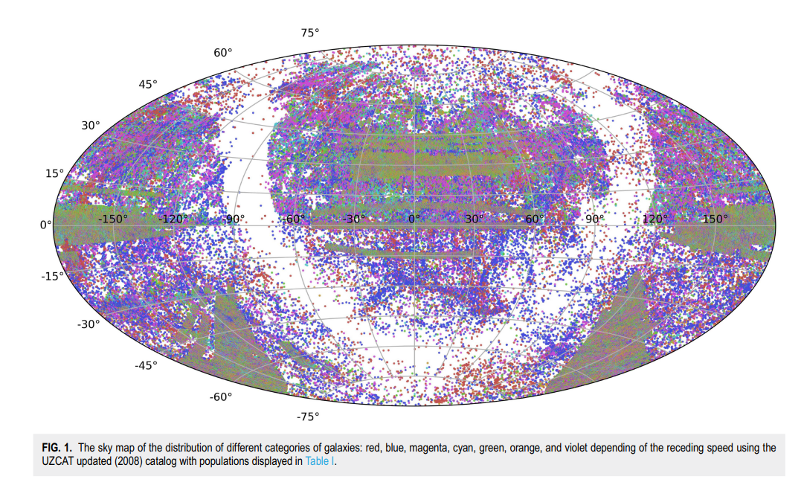
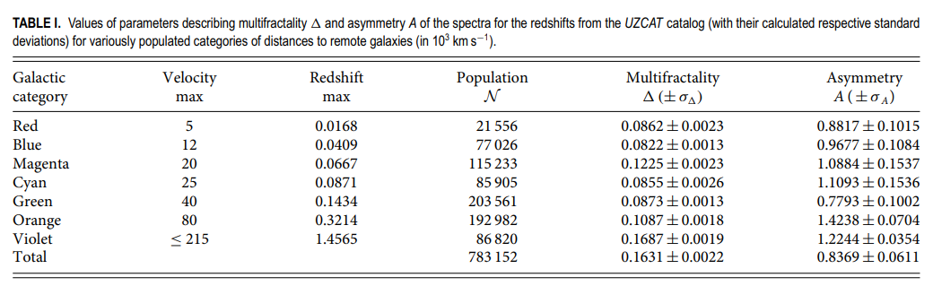
The Fractal Signature
Macek & Wójcik (2026) analysis of nearly 800,000* galaxies.
Large-scale structure follows a multifractal spectrum.
* 783,152
Notes:
Galaxy distribution isn't random. Macek data proves it's a fractal. This is the 'address system' for the projection.

Slide 4
The Mechanism
Entropy bounds limit cosmic information capacity.
Fractals optimize data density.
Notes:
Physics has a storage limit (Entropy). Fractal structure is the most efficient way to fit that info into the cell. Lamda is the cosmological constant/vacuum energy density, L is the IR (infrared) cut-off scale (The physical scale (size) of the system/universe.), and M_p is the Planck mass (The fundamental mass scale where gravity and quantum mechanics meet.) (Manoharan 2025 pre-print paper).

Slide 5
Conclusion
The Nested Cosmos
Coherent, wave-encoded reality
The holographic universe as an information-rich system.

